Slide 1
Programming Logic and Design Ninth Edition
Chapter 3
Understanding Structure

Slide 2
Objectives
In this chapter, you will learn about:
The disadvantages of unstructured spaghetti code
The three basic structures—sequence, selection, and loop
Using a priming input to structure a program
The need for structure
Recognizing structure
Structuring and modularizing unstructured logic

Slide 3
The Disadvantages of Unstructured Spaghetti Code
Spaghetti code
Logically snarled program statements
Often a complicated mess
Programs often work but are difficult to read and maintain
Confusing and prone to error
Unstructured programs
Do not follow the rules of structured logic
Structured programs
Follow the rules of structured logic

Slide 4
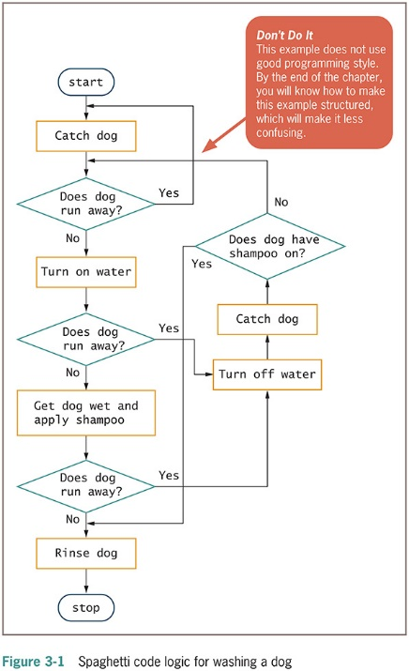
Unstructured Spaghetti Code

Slide 5
Understanding the Three Basic Structures
Structure
Basic unit of programming logic
Each structure is one of the following:
Sequence structure
Selection structure (decision structure)
Loop structure
any program can be constructed using one or more of these three structures

Slide 6
Understanding the Three Basic Structures (continued)
Sequence structure
Perform actions or tasks in order
No branching or skipping any task
Selection structure (decision structure)
Ask a question, take one of two actions based on testing a condition. Known as evaluating a Boolean expression, a statement that is either true or false
Often called if-then-else
Dual-alternative ifs or single-alternative ifs
Loop structure
Repeat actions while a condition remains true

Slide 7
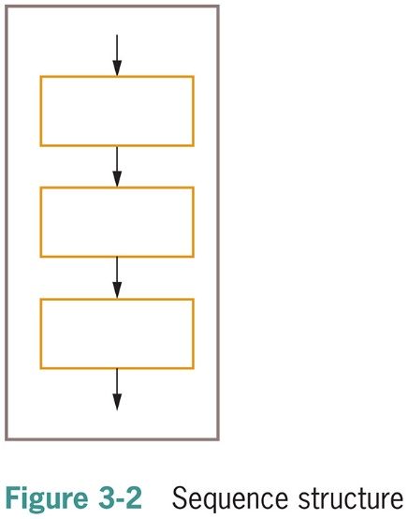
The Sequence Structure

Slide 8
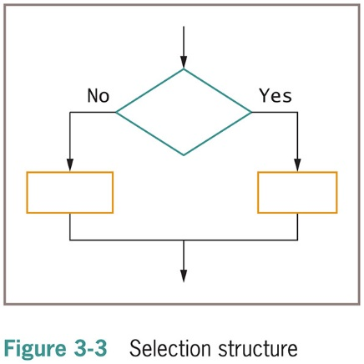
The Selection Structure

Slide 9
The Selection Structure (continued -1)
Dual-alternative ifs
Contains two alternatives
The if-then-else structure
if someCondition is true then
do oneProcess
else
do theOtherProcess
endif

Slide 10
The Selection Structure (continued -2)
Single-alternative ifs
if employee belongs to dentalPlan then
deduct $40 from employeeGrossPay
An else clause is not required
null case
Situation where nothing is done

Slide 11
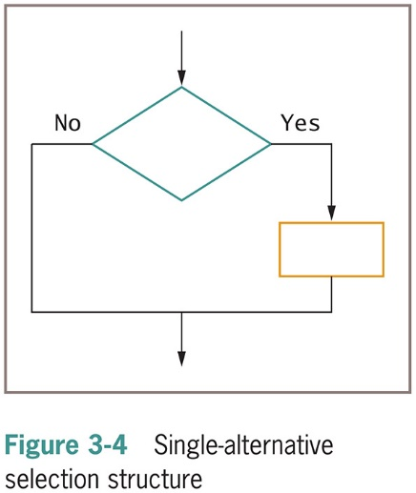
The Selection Structure (continued -3)

Slide 12
The Loop Structure
Loop structure
Repeats a set of actions while a condition remains true
Loop body
Also called repetition or iteration
Condition is tested first in the most common form of loop
The while…do or while loop

Slide 13
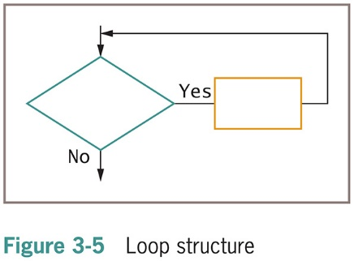
The Loop Structure (continued -1)

Slide 14
The Loop Structure (continued -2)
Loop structure
while testCondition continues to be true
do someProcess
endwhile
while you continue to be hungry
take another bite of food
determine if you still feel hungry
endwhile

Slide 15
Combining Structures
All logic problems can be solved using only sequence, selection, and loop
Structures can be combined in an infinite number of ways
Stacking structures
Attaching structures end-to-end
End-structure statement
Indicates the end of a structure
The endif statement ends an if-then-else structure
The endwhile statement ends a loop structure

Slide 16
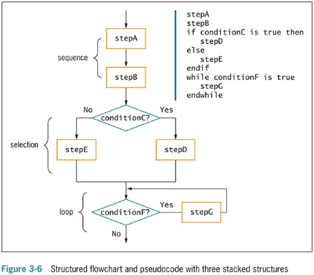
Combining Structures (continued -1)

Slide 17
Combining Structures (continued -2)
Any individual task or step in a structure can be replaced by a structure
Nesting structures
Placing one structure within another
Indent the nested structure’s statements
Block
A group of statements that execute as a single unit

Slide 18
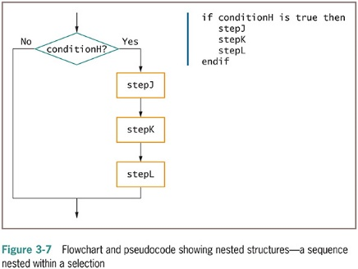
Combining Structures (continued -3)

Slide 19
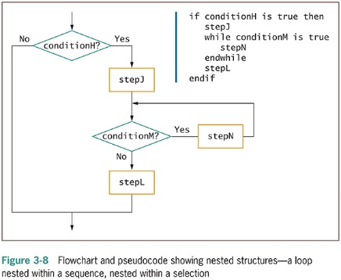
Combining Structures (continued -4)

Slide 20
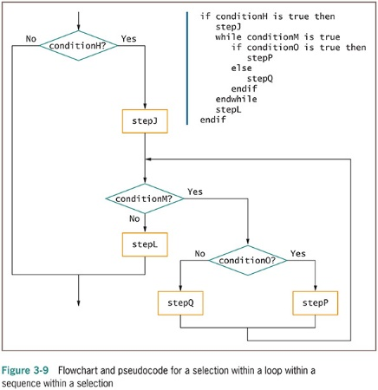
Combining Structures (continued -5)

Slide 21
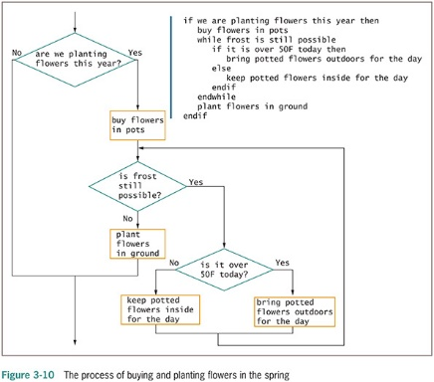
Combining Structures (continued -6)

Slide 22
Combining Structures (continued -7)
Structured programs have the following characteristics:
Include only combinations of the three basic structures
Each structure has a single entry point and a single exit point
Structures can be stacked or connected to one another only at their entry or exit points
Any structure can be nested within another structure

Slide 23
Using a Priming Input to Structure a Program
Priming input (or priming read)
Reads the first input data record
Is outside the loop that reads the rest of the records
Helps keep the program structured
Analyze a flowchart for structure one step at a time
Watch for unstructured loops that do not follow this order
First ask a question
Take action based on the answer
Return to ask the question again

Slide 24
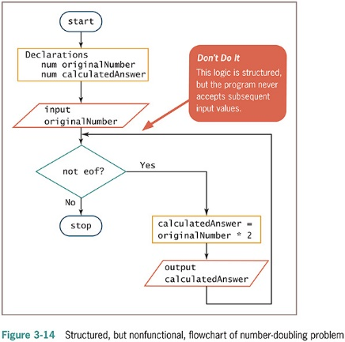
Using a Priming Input to Structure a Program (continued -1)

Slide 25
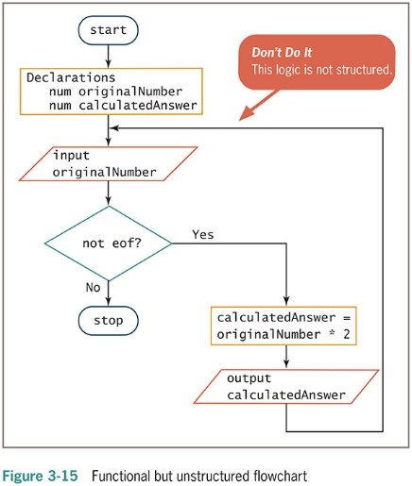
Using a Priming Input to Structure a Program (continued -2)

Slide 26
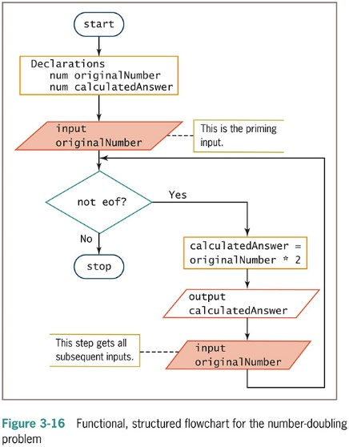
Using a Priming Input to Structure a Program (continued -3)

Slide 27
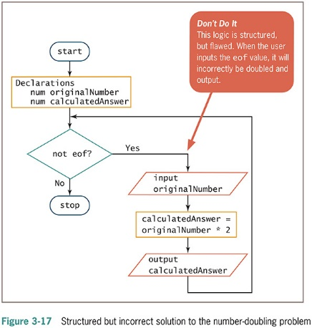
Using a Priming Input to Structure a Program (continued -4)

Slide 28
Understanding the Reasons for Structure
Use structured programming for:
Clarity—unstructured programs are confusing
Professionalism—other programmers expect it
Efficiency—most languages support it
Maintenance —other programmers find it easier to read
Modularity —easily broken down into modules
Structured programming is sometimes called goto-less programming

Slide 29
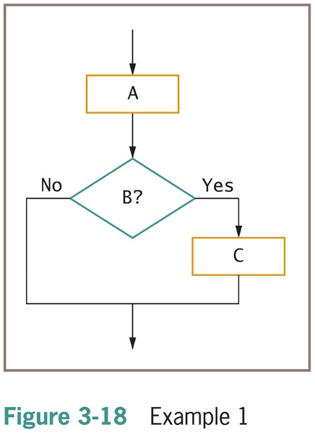
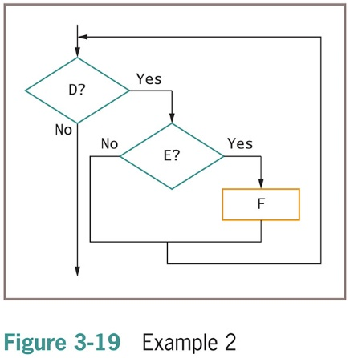
Recognizing Structure

Slide 30
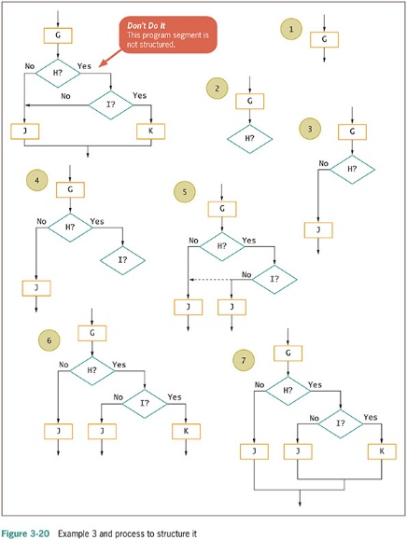
Recognizing Structure (continued -1)

Slide 31
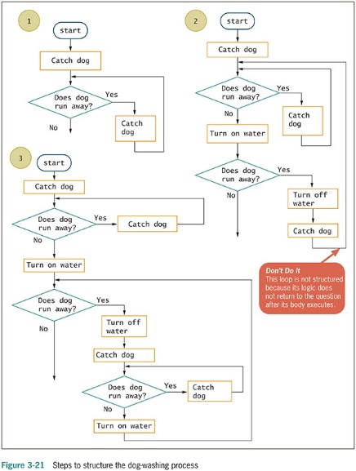
Recognizing Structure (continued -2)

Slide 32
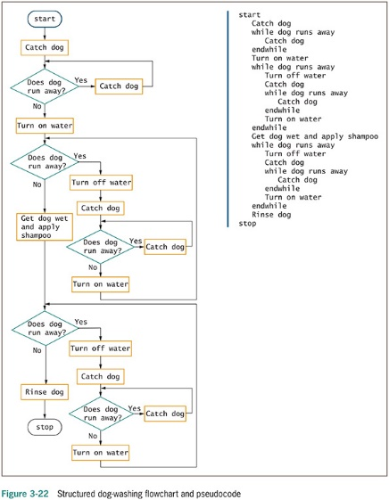
Recognizing Structure (continued -3)

Slide 33
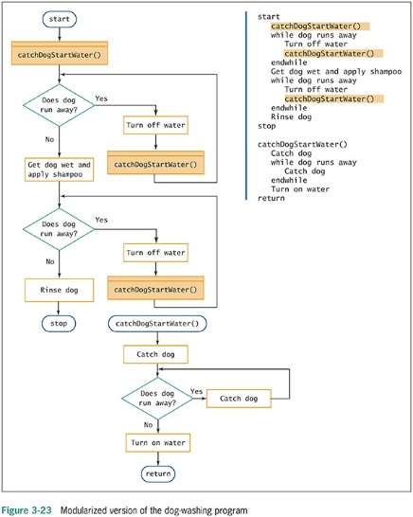
Recognizing Structure (continued -4)

Slide 34
Summary
Spaghetti code
Statements that do not follow rules of structured logic
Three basic structures
Sequence, selection, and loop
Combined by stacking and nesting
Priming input
Statement that reads the first input value prior to starting a structured loop

Slide 35
Summary (continued)
Structured techniques promote:
Clarity
Professionalism
Efficiency
Modularity
Flowcharts can be made structured by untangling logic
Logical steps can be rewritten to conform to the three structures: sequence, selection, and loop

